Slide 1
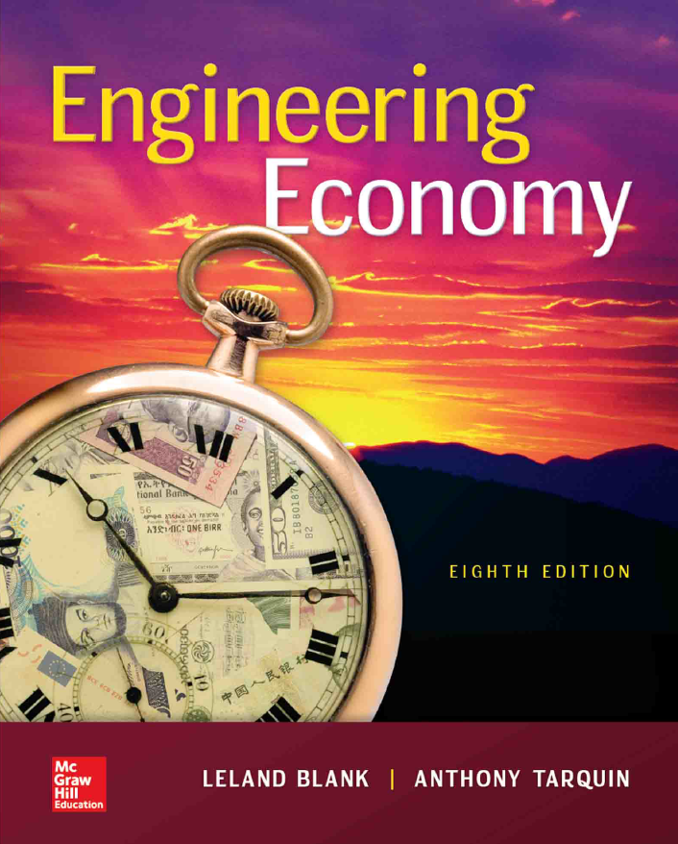

Chapter 1
Foundations Of Engineering Economy
Engineering Economy
8th edition
Leland Blank
Anthony Tarquin
1-<number>
Notes:
At this point:
1. Introduce yourself - your students are likely to want to know something about your qualifications and interests - overall, where you are coming from.
2. Have students introduce themselves. Ask why they are taking this class. If you are fortunate enough to have a Polaroid camera, take pictures of each student for later posting on a class “board” so both they and you get to know each other.
3. Discuss both choice of textbook and development of syllabus.
4. If you are expecting students to work in teams, at east introduce the choice of team members. If at all possible, have students participate in a team building or team study exercise. It works wonders. Most student have been told to work in teams in prior classes, but have never examined exactly what a team is and how it works. One hour spent in a team building/examination exercise saves many hours and avoids many problems later on.

Slide 2
LEARNING OUTCOMES
Role in decision making
Study approach
Ethics and economics
Interest rate
Terms and symbols
Cash flows
Economic equivalence
Simple and compound interest
Minimum attractive rate of return(MARR)
Spreadsheet functions
1-<number>

Slide 3


Simple
Vs.
Sophisticated
1-<number>

Slide 4
Why Engineering Economy is Important to Engineers
Engineers design and create
Designing involves
Engineers must be able to incorporate ___________ ___________ into their creative efforts
Often engineers must select and implement from
Understanding and applying ,
, and are vital for engineers
A proper for selection and execution is a fundamental task of engineering
1-<number>

Slide 5
Time Value of Money (TVM)
Description: TVM explains the _________ in the
amount of money ______ ______ for funds owed by or owned by a corporation (or individual)
  Corporate investments are expected to ______ ___ ___________
  Investment involves money
  Money has a ‘ ______ ________’
The is the most important concept in engineering economy
1-<number>

Slide 6
Engineering Economy
Engineering Economy involves
  , and
  expected economic outcomes of alternatives designed to accomplish a defined purpose
Estimates of economic outcomes can be
or in nature
Easy-to-use math techniques _______ the evaluation
1-<number>

Slide 7
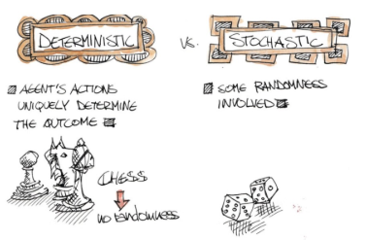
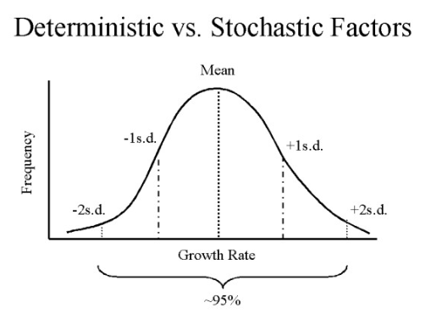
1-<number>

Slide 8
General Steps for Decision Making Processes
Understand the problem – Define __________
Collect __________ information
Define the set of feasible
Identify the ________ for decision making
Evaluate the alternatives and apply ___________ analysis
Select the “ ” alternative
Implement the alternative and monitor results
1-<number>

Slide 9
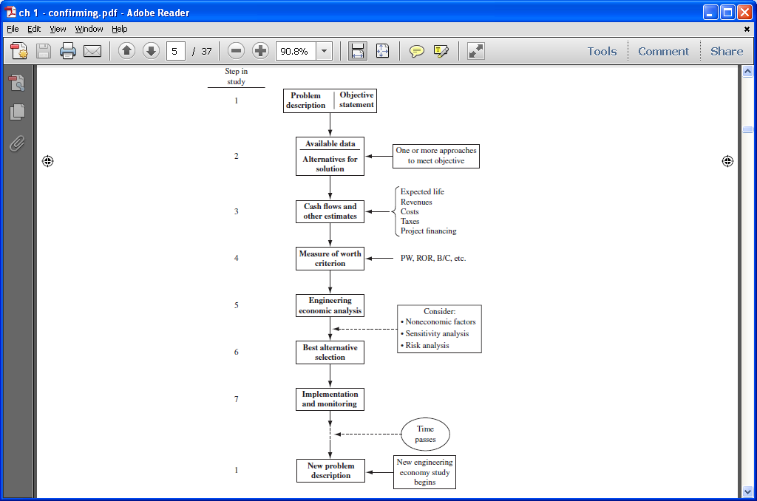
Steps in an Engineering Economy Study
1-<number>

Slide 10
Ethics – Different Levels
Universal morals or ethics – Fundamental beliefs: stealing, lying, harming or murdering another are wrong
Personal morals or ethics – Beliefs that an individual has and maintains over time; how a universal moral is interpreted and used by each person
Professional or engineering ethics – Formal standard or code that guides a person in work activities and decision making
1-<number>

Slide 11
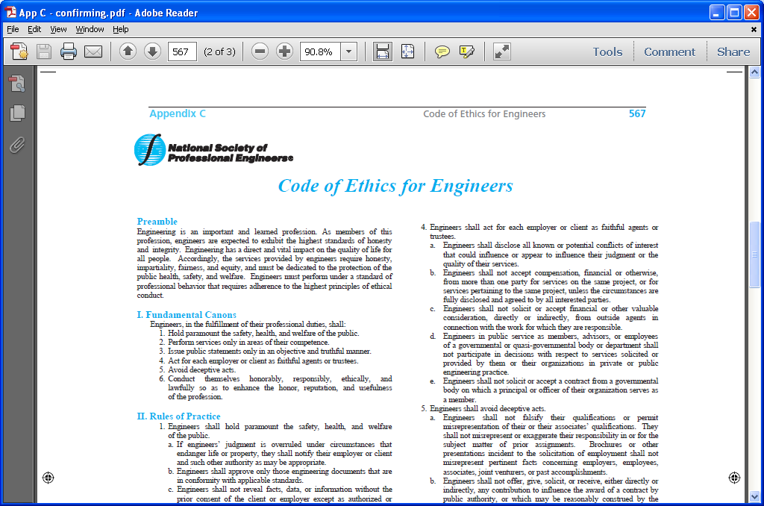
Code of Ethics for Engineers
All disciplines have a formal code of ethics. National Society of Professional Engineers (NSPE) maintains a code specifically for engineers; many engineering professional societies have their own code
1-<number>

Slide 12
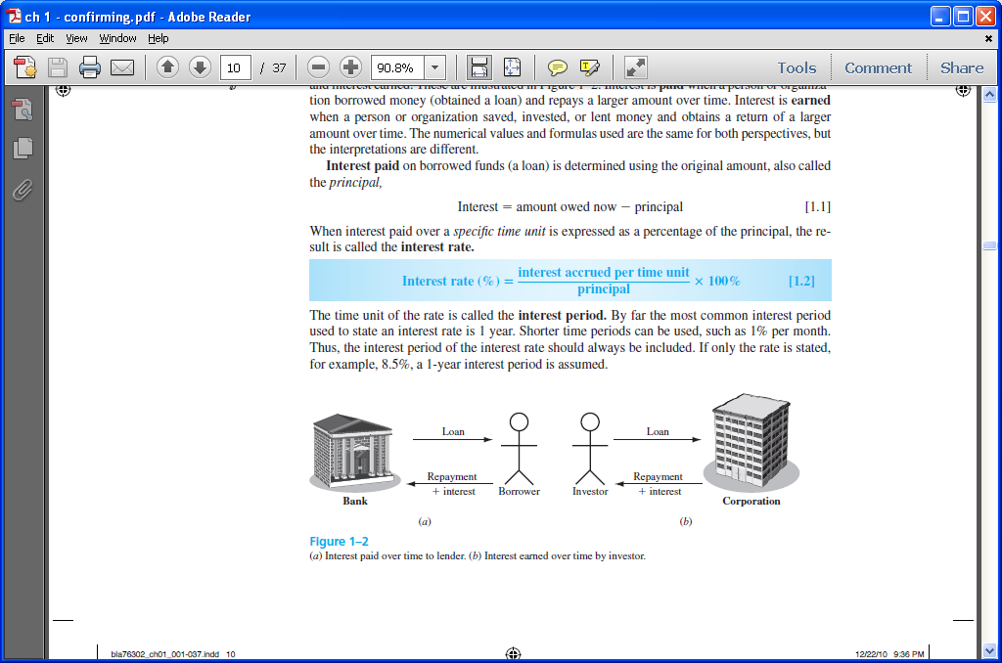
Interest and Interest Rate
Interest – the of the time value of money
  Fee that one pays to use someone else’s money
  between an ending amount of money and a beginning amount of money
    Interest =
Interest rate – Interest paid over a time period expressed as a
1-<number>

Slide 13
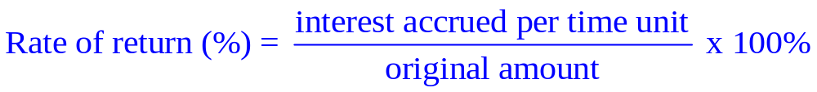
Rate of Return
Interest earned over a period of time is expressed as a percentage of the original amount ( ___________ )
Borrower’s perspective – interest rate
Lender’s or investor’s perspective – rate of return
1-<number>

Slide 14
Interest paid Interest earned
1-<number>

Slide 15
Commonly used Symbols
= time, usually in periods such as years or months
= value or amount of money at a time t designated as present or time 0
= value or amount of money at some future time, such as at t = n periods in the future
= series of consecutive, equal, end-of-period amounts of money
= number of interest periods; years, months
= interest rate or rate of return per time period; percent per year or month
1-<number>

Slide 16
Cash Flows: Terms
Cash Inflows – Revenues (R), receipts, incomes, savings generated by projects and activities that . sign used
Cash Outflows – Disbursements (D), costs, expenses, taxes caused by projects and activities that . sign used
Net Cash Flow (NCF) for each time period:
  NCF = = R – D
:
  Funds flow at the end of a given interest period
1-<number>

Slide 17
Cash Flows: Estimating
– A single-value estimate of a cash flow element of an alternative
  Cash inflow: Income = $150,000 per month
– Min. and Max. values that estimate the cash flow
Cash outflow: Cost is between $2.5 M and $3.2 M
Point estimates are commonly used; however, range estimates with probabilities attached provide a better understanding of variability of economic parameters used to make decisions
1-<number>

Slide 18
Cash Flow Diagrams
A typical __________________ might look like
1. Draw a time line
Always assume ____________________ cash flows
Time
0 1 2 … … … n - 1 n
One time period
F = $100
2. Show the cash flows and discount(interest) rate
0 1 2 … … … n-1 n
Cash flows are shown as directed arrows: + (up) for ___flow
- (down) for ____flow
P = $-80
i=10%
1-<number>

Slide 19
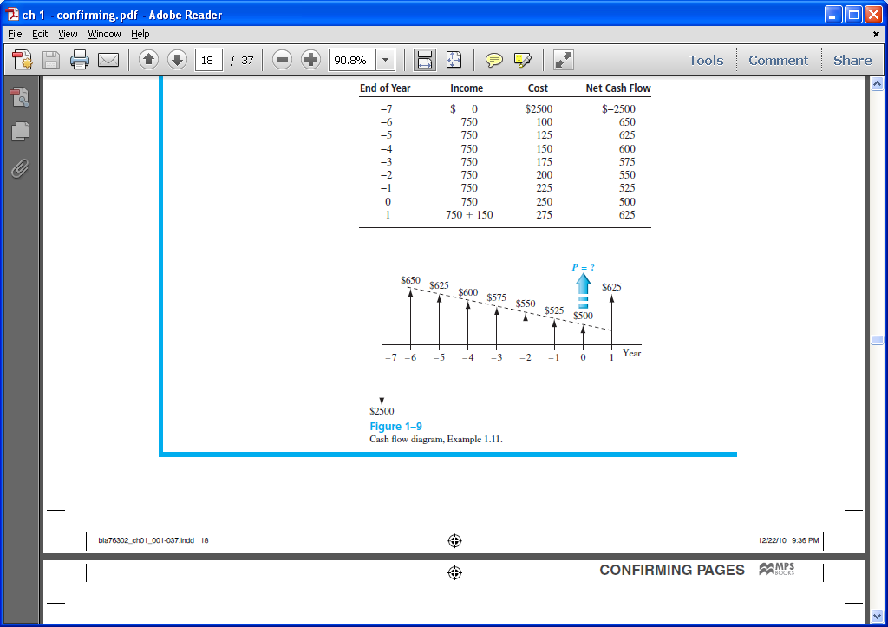
Cash Flow Diagram Example
Plot observed cash flows over last 8 years and estimated sale next year for $150. Show present worth (P) arrow at present time, t = 0
1-<number>

Slide 20
Economic Equivalence
Definition: Combination of (rate of return) and to determine different amounts of money at different points in time that are economically
How it works: Use rate i and time t in upcoming relations to move money (values of P, F and A) between time points t = 0, 1, …, n to make them (not equal) at the rate i
1-<number>

Slide 21
Example of Equivalence
Different sums of money at different times may be at a given rate
$110
Year
0 1
Rate of return = 10% per year
$100 now
$100 now is economically equivalent to $110 one year from now, if the $100 is invested at a rate of 10% per year.
1-<number>

Slide 22
Simple and Compound Interest
Simple Interest
  Interest is calculated using .
  Interest = (principal)(number of periods)(interest rate)
  I = Pni
Example: $100,000 lent for 3 years at simple i = 10% per year. What is repayment after 3 years?
Interest = 100,000(3)(0.10) = $30,000
Total due = 100,000 + 30,000 = $130,000
1-<number>

Slide 23
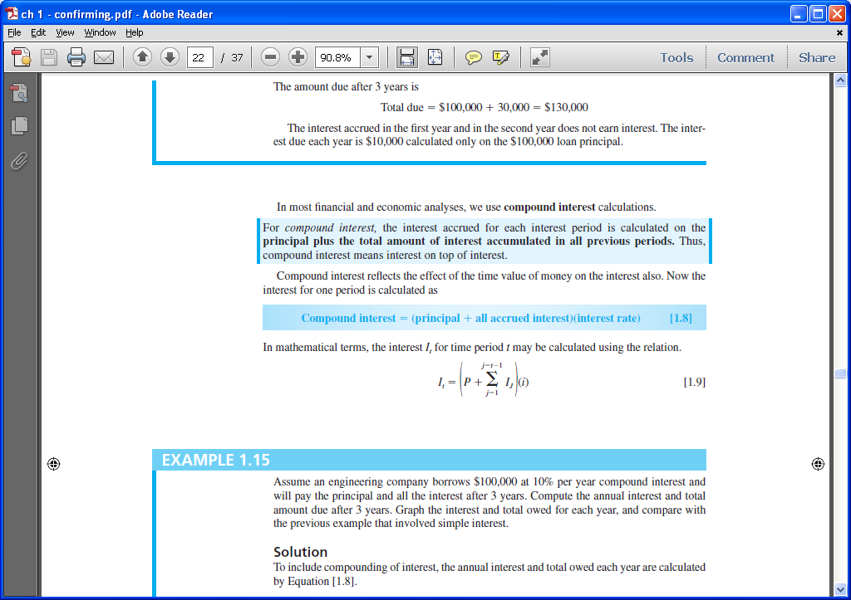
Simple and Compound Interest
Compound Interest
  Interest is based on principal plus all accrued interest
  That is, over time
  Interest = (principal + all accrued interest) (interest rate)
Interest for time period t is
1-<number>

Slide 24
Compound Interest Example
Example: $100,000 lent for 3 years at i = 10% per year compounded. What is repayment after 3 years?
Interest, year 1: I₁ = 100,000(0.10) = $10,000
Total due, year 1: T₁ = 100,000 + 10,000 = $110,000
Interest, year 2: I₂ = 110,000(0.10) = $11,000
Total due, year 2: T₂ = 110,000 + 11,000 = $121,000
Interest, year 3: I₃ = 121,000(0.10) = $12,100
Total due, year 3: T₃ = 121,000 + 12,100 = $133,100
Compounded: $133,100 Simple: $130,000
1-<number>

Slide 25
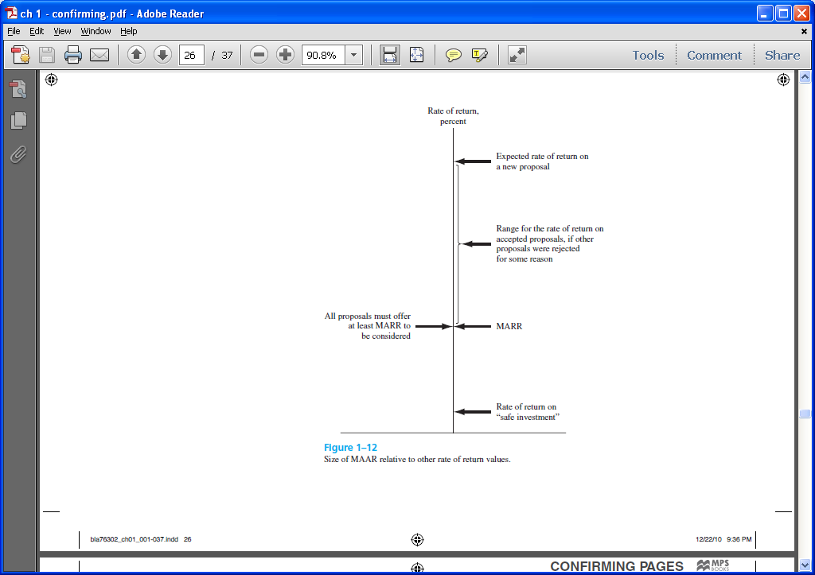
Minimum Attractive Rate of Return
MARR is a rate of return (percent) established for evaluating and selecting alternatives
An investment is
if it is expected to return the MARR
Also termed ,
and cutoff rate
1-<number>

Slide 26
MARR Characteristics
MARR is established by the financial managers of the firm
MARR is fundamentally connected to the
Both types of capital financing are used to determine the (WACC) and the MARR
MARR usually considers the _____ inherent to a project
1-<number>

Slide 27
Types of Financing
– Funds either from retained earnings, new stock issues, or owner’s infusion of money.
– Borrowed funds from outside sources – loans, bonds, mortgages, venture capital pools, etc. Interest is paid to the lender on these funds
For an economically justified project
ROR ≥ MARR > WACC
1-<number>

Slide 28
Opportunity Cost
Definition: Largest rate of return of all projects not accepted (forgone) due to some reasons
If no MARR is set, the ROR of the project not undertaken establishes the opportunity cost (the de facto MARR)
※ “the ______ of potential gain from ________ alternatives when one alternative is chosen” – New Oxford American Dictionary
1-<number>

Slide 29
Introduction to Spreadsheet Functions
Excel financial functions
  Present Value, P: = PV(i%,n,A,F)
  Future Value, F: = FV(i%,n,A,P)
  Equal, periodic value, A: = PMT(i%,n,P,F)
  Number of periods, n: = NPER(i%,A,P,F)
  Compound interest rate, i: = RATE(n,A,P,F)
  Compound interest rate, i: = IRR(first_cell:last_cell)
  Present value, any series, P: = NPV(i%,second_cell:last_cell) + first_cell
  Example: Estimates are P = $5,000 n = 5 years i = 5% per year
  Find A in $ per year
  Function and display: = PMT(5%, 5, 5000) displays A = $1,154.87
1-<number>

Slide 30
HOMEWORK
Please solve every Examples in your textbook. You do not have to submit your works.
Please upload following “PROBLEMS” solution file on “Assignment” menu in e-Class.
  1.18
  1.25
  1.33
  1.40
  1.45
  1.61
1-<number>

